Slide 1
Navigating the Sky
Constellations, Planets, Comets, Nebulae, Double Stars, Open Clusters, Globulars, Galaxies
How do I find them?!!

Slide 2
How do I get started?
Find an area with low light pollution (away from city lights)
Pick a time that does not conflict with a full or nearly full moon
Fall, Winter, early Spring – Dress warmly!
Summer – take a jacket & bug repellant!
Take a red lens flashlight & a regular flashlight
Take a viewing aid(s)
Take a friend or a group of friends
Have a plan

Slide 3
Ways to View
Naked eye
Binoculars
Telescope(s)

Slide 4
Have a Plan
Start by identifying the brighter stars for the season & time-of-night
Identify the constellations that contain these brighter stars & try to find the other, dimmer stars in these constellations (use binoculars, if needed)
Start with the part of the sky that is darkest for your viewing area (don’t try to find stars in the glow of a close-by city)
Use viewing aids for planning & actual viewing (set some goals beforehand)

Slide 5
Helpful Tips
Don’t try to view “faint fuzzies” until you know your way around the sky
If you have a GOTO scope turn off the GOTO function for the 1st year (use the keypad to move the scope, but use the finder scope to locate objects in the sky – take xtra batteries for both!!)
Use low-power EPs (higher # of mm, 25mm or 30mm) – high power magnification is rarely your friend, but field-of-view is!
If your scope has a 6x35 or smaller finder scope consider replacing it with a red-dot finder

Slide 6
Helpful Tips (cont)
Once you’re familiar with a few constellations, try to find a bright nebula, double star, or globular cluster within that constellation (use a viewing aid to identify the name, location & brightness); start with the Messier objects
Brightness is measured by magnitude, but Mag 1 is brighter than Mag 2, and Mag -1 is brighter than Mag 1 ! Start by viewing objects of Mag 7.5 or brighter (the bigger the number, the dimmer the object)
Don’t forget the planets. Jupiter, Saturn, Venus, Mars & Mercury are interesting objects to view. Jupiter with its 4 major moons and Saturn with its rings provide views in even small scopes that will blow your socks off!
Visit a “Star Party” in your state
Join GRAAA – associate with other amateur astronomers!
Buy a green (not red!) laser pointer – everyone in your group will know where you’re looking in the sky – resist pointing it at aircraft!!

Slide 7
Remember!
Telescopes have small fields of view compared the naked eye or even binoculars. As a result, telescopes are useless for identifying constellations
If your scope uses mirrors (Newtonian) learn how to collimate (align) it
Celestial objects move across the sky at the rate of 15 deg/hour, because of the earth’s rotation –an object on the eastern horizon will be much easier to see 2 or 3 hours later. Wait until it is higher in the sky to attempt viewing – you’re looking thru less atmosphere

Slide 8
Remember!
You won’t see nebulae and galaxies in color as usually depicted on the box that contained your telescope. Our eyes are not designed to see the color of faint light & the manufacturers are guilty of false advertizing!
Because of seasonal differences it will take at least a year to become familiar with the major constellations – be patient!
If Michigan weather treats you to unexpected clear skies for even an hour or so, take advantage of it by simply walking out into the yard (away from bright lights) and identifying the major stars and a few constellations. Practice makes perfect!
Visit the GR Planetarium – where the skies are always clear!

Slide 9
Viewing & Planning Aids
Books
Periodicals (magazines)
On-line
Computer Based
I-Touch, I-Pad Apps

Slide 10
Good Books
Night Watch by Terrence Dickenson considered a classic; has charts by season & a neat tour of the universe in 11 steps; great color photos; $30)
Starwatch by Mike Lynch (published by state, but any mid-western state will work); has charts by month & season; great color photos; sold cheap at used book stores -$10
Secrets of Stargazing – Skywatching Tips and Tricks by Becky Ramotowski, Sky & Telescope ; good technical information including collimation of Newt scopes; how to use a equatorial mount; types of scopes & mounts - $14

Slide 11
Good Books (cont)
Astronomy with Small Telescopes by Stephen Tonkin ; telescope oriented, no charts; black & white
A Simple Guide to Telescopes, Spotting Scopes, and Binoculars by Bill Corbett; good color pics & technical info for mounts, scopes, collimation, binoculars; available at bargain book stores ; $10 or less
The Sky Observers Guide (a Golden Guide) – a small handbook; mostly illustrated by drawings; $cheap

Slide 12
Magazines
Sky and Telescope – published a month in advance to allow time for planning; good sky chart for that month; Sky at a Glance; Binocular Highlights; Sun, Moon, and Planets including charts of Jupiter and Saturn moon positions by hour; new product reviews; good technical articles; astro imaging articles; great color pictures by amateurs
Astronomy – very similar to Sky and Telescope
Astronomy Now – published in England with European flavor
Astronomy Technology Today – more technically oriented toward latest products

Slide 13
On-Line
Both Sky and Telescope & Astronomy magazines have extensive on-line viewing helps and charts by viewing area
Huge amount of on-line information

Slide 14
Computer-Based Planetarium S/W
Starry Night series by Orion Telescopes – 4 versions priced from $49.95 to $249.95
AutoStar Suite by Meade
The Sky by Software Bisque (several price levels)
Sky Map Pro
Earth Centered Universe - $30 for Lite & $80. for Pro version
Stellarium – free
HNSKY (Hallo Northern Sky)
Cartes Du Ciel
Night Vision
Sky Atlas
TUBA (Touring the Universe Through Binoculars Star Atlas)
NGC View 32
Desktop Universe

Slide 15
IPAD, ITOUCH Apps
pUniverse
Grand Tour
Distant Suns
StarMap 3D

Slide 16
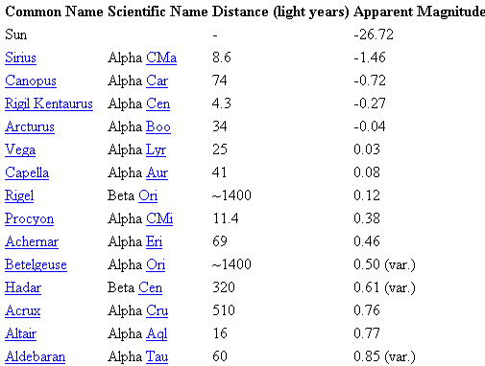
25 Brightest Stars (7 in So. Hemisphere & not visible)

Slide 17
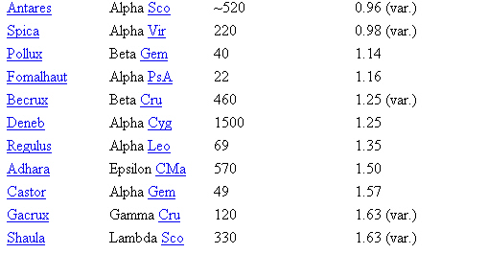
25 Brightest Stars (cont)

