Slide 1
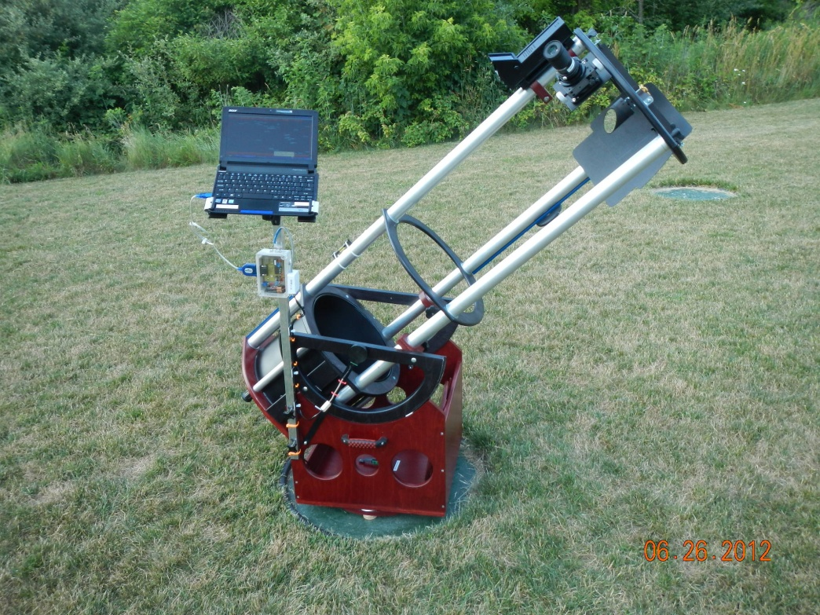
Looking Up & Looking Ahead
blow the dust off your telescope & start using it!!

Slide 2
How do I re-kindle my interest in astronomy??
add ‘BLING’ to your telescope with accessories
upgrade your existing equipment
increase your social experiences
use the new technologies
try your hand at astro-imaging
add pizzaz to your public viewing with near real-time video imaging

Slide 3
Add “BLING” to your scope
upgrade your small finder scope to a ‘reflex’ finder or good quality optical finder, or even a green laser
buy a good, wide FOV (65 or 82 deg) eyepiece (EP) or 2 (25mm & 10mm are good choices)
replace your rack & pinion focuser with a Crayford (much better control) or replace your existing Crayford with a 10x version (very fine focus control)
Newtonian owners - invest in a laser collimator & learn how to use it
replace your scope mount with a sturdier mount & tripod
if you are using an equatorial mount & find it awkward to use, switch to a modern alt-az mount (1 2 3 4 5)

Slide 4
Add “BLING” to your scope (cont)
if your scope is the weak link replace it with a better one
if you have a ‘Costco’ special replace the whole enchilada (recommend a 6”- 8” Dobsonian – easy to use & good optics – cost approx. $250.+)
if you own a usable Dobsonian consider adding digital setting circles (DSCs) to increase its usefulness
if you frequently experience problems with dew invest in a heater for your scopes secondary mirror, finder scope & primary (if needed)

Slide 5
Add “Bling” to your Binoculars
If you own binoculars use them for astronomy – 7x35 or 10x50 are good combinations; the 1st number is power (7 or 10) & the 2nd number is the diameter of the front lens in mm (35 or 50). The light gathering capability is proportional to the square of the 2nd number, & is more important than the power. If you plan to buy binoculars be sure the lens are FULLY, MULTI –Coated (avoid ruby-colored coatings). 10x50 is a good combination.
Consider getting or building a binocular holder/stabilizer. For detailed viewing binoculars must be “held” steady. With steady binoculars you can view the 4 moons of Jupiter & the rings of Saturn as well as many deep-space objects.

Slide 6
Add social experience to your hobby
join the GRAAA for camaraderie, help, mentoring, good speakers, availability of 1st class instruments for your use, special events…
attend a star party (take your spouse, kids, grandkids)
host a 1-evening neighborhood star party
take your family to the GR Planetarium
subscribe to an astronomy magazine (Sky & Telescope, Astronomy, Astronomy Now (British) are good selections & are sold here at Schuler’s.
involve/mentor your kids, grandkids or neighbor kids (get them away from their video games)

Slide 7
Incorporate Technology into Your Astronomy Hobby
add astronomy apps to your smart phone/tablet/laptop – many are free or are only a few bucks; read reviews before downloading & take time to read the instructions
install a planetarium program on your laptop – some are free, many allow you to buy the version with only the features you need & priced accordingly. Most can used to control GOTO (robotic) scopes.
buy an approved solar filter to fit your scope & enjoy sun spot viewing; also try a light pollution filter for normal viewing
investigate the world of GOTO computerized mounts – come in alt-az as well as equatorial versions at a wide range of prices & weight handling capability. These mounts have revolutionized amateur astronomy. Many of us in the GRAAA have them & can help you pick one & show you how to use it. With a GOTO scope & mount you will see more objects in an evening, than perhaps in a month of manual observation
(important with MI having so few good viewing nights)

Slide 8
Stuff for the highly Motivated
“pimp” your heavy tube-style Dobsonian into a minimalist (light weight & portable) truss-style Dob (we have club members who have done this & also have a nice example of one at the Veen that GRAAA members can use)
Consider building an observatory in your yard, however:
don’t do it unless you have low light pollution
do it in phases (easier to slide by your CFO), & have a long-term plan in mind)
start by simply putting your mount on a sturdy pier (leave mount on the pier - polar align & level, once)

Slide 9
More Stuff for the highly Motivated
Try advanced solar viewing (flares, corona, CME) using specialized scopes. The GRAAA now has one up & running! This extends your viewing time into the daylight hours (you don’t need as much sleep as you think)
Use your smart phone or point & shoot camera for quick, but fun imaging thru the eyepiece

Slide 10
Try astro-imaging
astro-imaging is NOT for the faint of heart, but the results are addictive!
images can now be made by amateurs that rival observatory images
consumer grade DSLRs may be used for the imager by simply attaching to your OTA via a camera specific adapter
the Veen is fully equipped for imaging, & is available to members following training

Slide 11
Try astro-imaging (cont)
astro-imaging does impose some equipment requirements – know these before embarking down this slippery slope!
the learning curve is steep, but several GRAAA members serve as mentors – don’t go it alone!
several new hi-tech devices allow 1 to 2 hour tracking for DSLRs without the need for fully guided equatorial mounts. These are primarily for DSLRs & camera lenses, not for heavy scopes, and are very transportable (1 2 3 4)

Slide 12
Video-imaging
video-imaging is rapidly becoming a favorite of the imaging crowd
long frame times (by video standards) provide very detailed images in near real time (once per minute as an example)
great for displaying DSOs on large video screens for public viewing
no post-processing is required

Slide 13
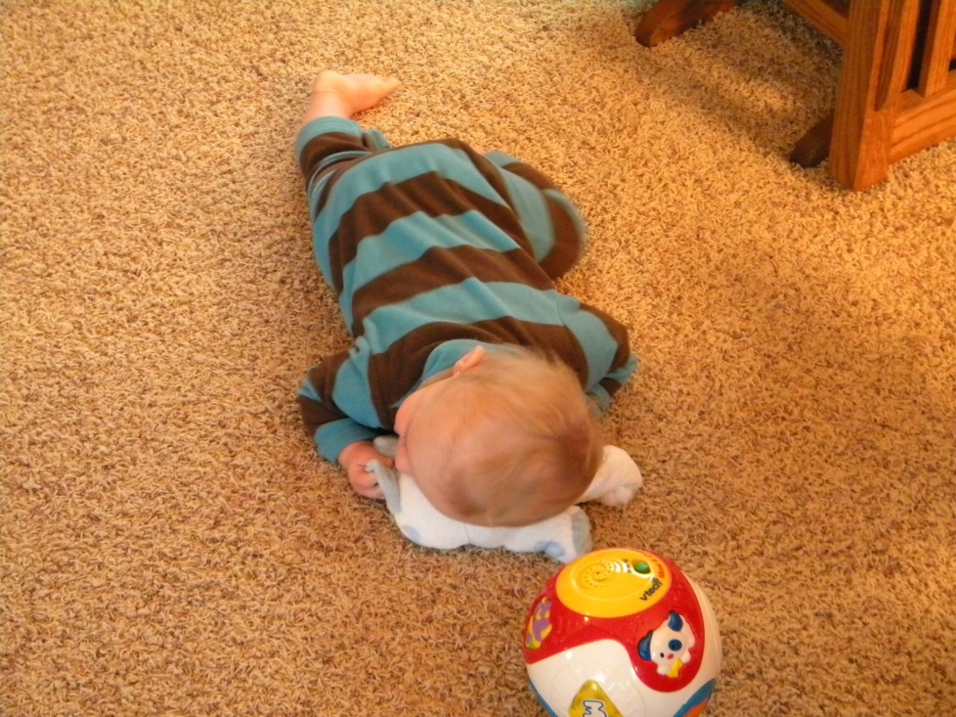
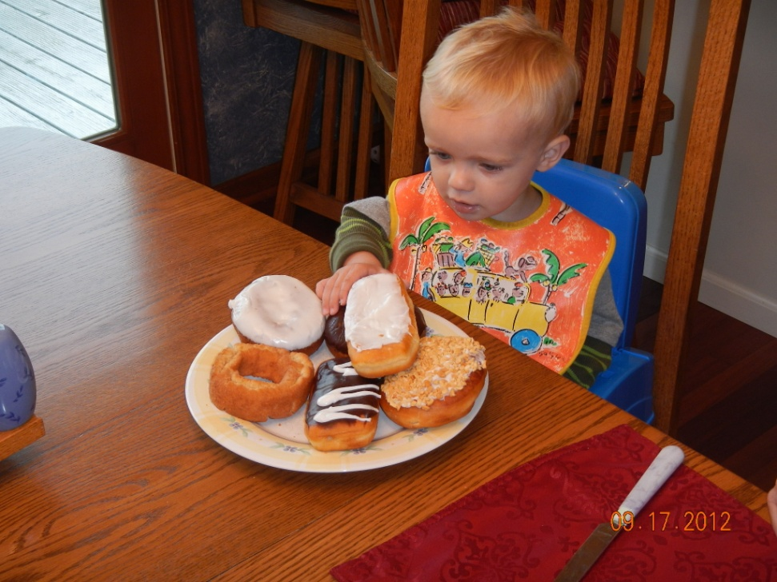
don’t sleep thru the night!
enjoy astronomy!!

Slide 14
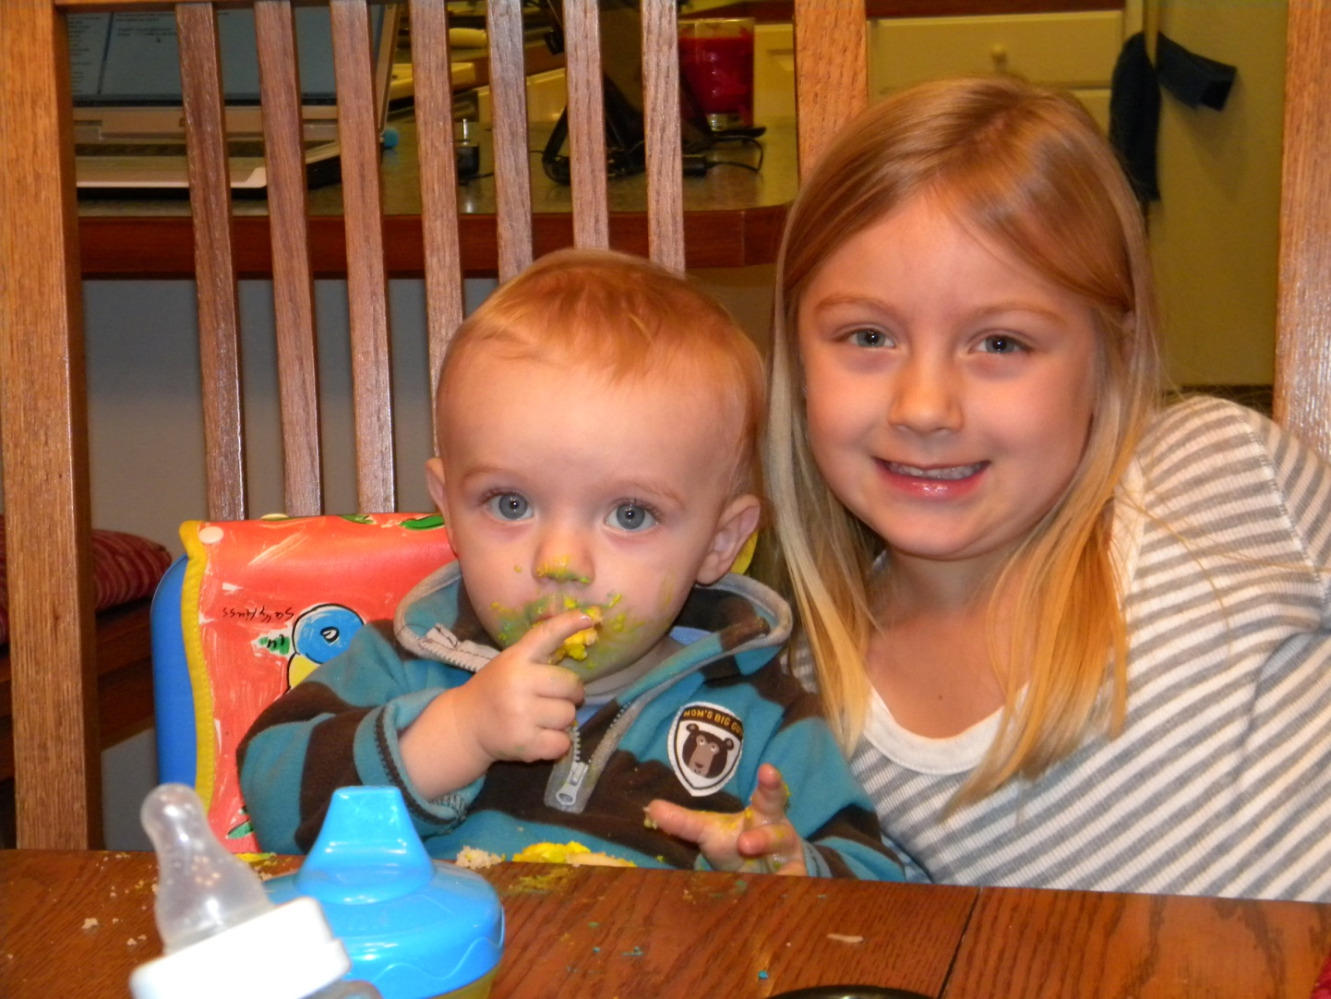
the end

Slide 15
Email address: greg_comegys@charter.net
Website: gregswebsite.weebly.com

Slide 16
Reflex (1x) Finders

Slide 17
Optical & Green Laser Finder

Slide 18
Nearly Useless Optical Finder

Slide 19
Basic Rack & Pinion & Crayford Focusers

Slide 20
Laser Collimator (very handy)

Slide 21
Typical Grab & Go Alt – Az Mount

Slide 22
Alt – Az mount with slo-mo (knobs not shown)

Slide 23
Yet another alt-az mount (can hold 1 or 2 scopes)

Slide 24
DSV-1 shown with 2 scopes

Slide 25
DSV-1 with heavy scope

Slide 26
Typical no-frills dobsonians very easy to use!

Slide 27
Anti-dew heaters & dew shield (DIY)

Slide 28
Binocular mount/stabilizer (binoculars must have a threaded mount insert)

Slide 29
James Veen Observatory

Slide 30
Veen Observatory Setting up for public night

Slide 31
Transit of Venus – Cascade Park

Slide 32
“Pimp” your heavy Dob
Original Dob by Discovery
Converted Dob by DobSTUFF.com

Slide 33
“Pimped” scope ready for travel! (Handles with wheels are removable)

Slide 34
Planetarium Software Earth-Centered Universe

Slide 35
Approved (safe) Solar Filters
for binoculars
for all sizes of scopes

Slide 36
AstroTrac Imaging Tracker

Slide 37
AstroTrac with DSLR & Telephoto Lens

Slide 38
Tracker for DSLR & Telephoto Lens
NanoTracker
With Camera

Slide 39
Ioptron ‘s version of small Tracker

Slide 40
Mallincam Extreme Video Camera

Slide 41
Bracket to attach iPhone to Eyepiece

Slide 42
Have fun with your smart phone
iPhone Bracket
iPhone image

Slide 43
Have fun with your point & shoot camera
Bracket
Saturn with Coolpix L100

Slide 44
Observatory – Phase I

Slide 45
Observatory –phase 1

Slide 46
Observatory – phase ii

Slide 47
M42 – orion nebula

Slide 48
Typical family star party

Slide 49
Imaging scopes on a GOTO mount

Slide 50
Don’t shine your green laser on airplanes!! (you’ll go to jail)

