Slide 1
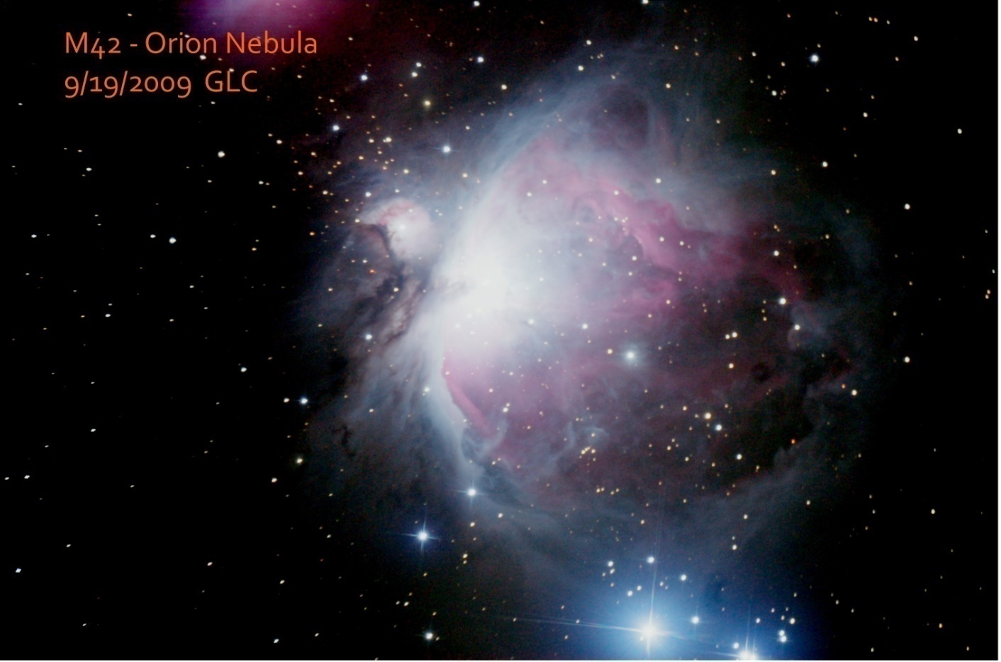
Getting Started in Astro-Imaging

Slide 2
What We’ll Talk About
What “hooked” me on astro-imaging
Why would you want to astro-image?
How to get started- you have some options
The simplest way - don’t bite off too much to start with
Basic equipment needed for short-exposure imaging
Short exposure limitations

Slide 3
What We Won’t Talk About!
Long exposure imaging options
Basic equipment and s/w needed for long exposure image tracking
Focusing – harder than you might think
Camera control
Image processing – some examples
Some Caveats
Advanced stuff – Photoshop processing
Fun stuff with long exposure
Come to the May 21 GRAAA Mtg @ the Veen Observ-atory for a presentation on advanced astro-imaging!!

Slide 4
How did I get hooked? (by images like the one below)

Slide 5
Why would you want to image?
Modern CCD/CMOS cameras are relatively cheap & easy to use
Results are immediate – no trips to the film developer (successes are saved - failures are trash-binned)
Color images are as easy as B/W - one-shot color with modern cameras (no red-green-blue filters needed)
Details of “dim objects” come alive
Cameras can record what the eye cannot see
Results can be shared with friends (those wimps who won’t join you at the eye piece)
It’s Fun!!

Slide 6
3 Optical Options for Imaging
Afocal – camera with fixed lens attached to telescope EP (generally for point & shoot cameras)
EP projection – camera without lens (typically a DSLR) attached to telescope with special adapter holding the camera and EP – provides some variability in magnification which is greater than that for prime focus
Prime focus – camera w/o lens attached directly to telescope focuser (fixed magnification) – typically used for advanced imaging

Slide 7
Williams Optics Universal Digi-Adapter for Afocal Imaging
Fine adjustments for alignment to EP. Comes in 2 sizes: 28-45mm & 43-65mm. Cost: $45. Has standard tripod mounting hole in the base.
(Will not support larger point & shoot cameras.)

Slide 8
EP Projection Adaptor
EP is internally mounted. Barrel slides to provide some adjustment in magnification. Shown as modified for 2” focuser – typically made for 1 ¼” focuser. Attaches to DSLR with T-ring.

Slide 9
Nikon D50 DSLR with 1 ¼” focuser adaptor installed for prime-focus imaging

Slide 10
Camera Options
Consumer point & shoot cameras
Consumer Digital SLRs
Web cameras, modified & unmodified
Video cameras
Cell phone camera?
Cameras designed specifically for astro-imaging (generally expensive & intended for advanced imaging

Slide 11
Basic Equipment for Getting Started
A telescope
A tracking mount for your telescope - either a GEM or Alt-Az will work for short exposure ,< 30 secs, imaging (a tracking mount compensates for earth’s rotation)
A digital “point and shoot” camera
Suitable mount for camera (digi-adaptor or similar)
Warm clothes & patience
An understanding spouse
Start simply & let success carry you to the next level

Slide 12
How to Take that 1st Image
Attach point & shoot camera with suitable adaptor & low power EP (25 -35mm) to telescope (may have to re-balance scope)
Set camera “white balance” to daylight & color to “standard”
Pick a bright object to image (moon, Jupiter, Saturn, Mars, comet, Orion nebula) and center in EP
Adjust camera mount to center the object
Adjust zoom to preference
Turn off flash
Turn on time delay
Take picture! (camera should autofocus & adjust exposure time)
You might want to practice the procedure on a “fixed”, terrestial object (it’s easier in the daylight)

Slide 13
Williams Optics Universal Digi-Adapter
Simple & inexpensive way to use a digital point & shoot camera for afocal imaging

Slide 14
Williams Optics Universal Digi-Adapter
Shown with camera (typical point & shoot) and EP attached. This adapter is somewhat heavy. Orion sells 2 models, SteadyPix Deluxe ($45) & SteadyPix Universal ($30), both of which are lighter. SteadyPix Deluxe will handle larger point & shoot cameras as well as DSLRs (almost too heavy, however)

Slide 15
Using a DSLR – offers more versatility
Software control using cameras USB connection to set ISO, exposure time, picture quality, etc.
Full hands off control using computer or remote exposure trigger
Images may be downloaded to computer via USB
Manual setting on camera is used, giving you full control of camera settings
Long (several minutes) exposures are possible
Not limited to jpg image types
DSLR & telephoto lens may used on GEM in place of telescope
Attaches directly to focuser via T-ring
Generally used in prime focus or EP projection mode
There are some “howevers”!!
However -focusing requires special consideration (view finder not very useful, but newer DSLRs have Live-View which helps with focusing)
However - camera may not be brought to focus on many Newtonians, unless designed for imaging (imaging chip is a full 55mm behind the camera lens mounting plate – this is a holdover from 35mm film SLRs)

Slide 16
T-Ring Adapter for DSLR (specific to camera brand)
T-ring shown with 1 ¼” adaptor.

Slide 17
DSLR with lens removed, ready for adaptors
Both 1 ¼” and 2” are available – must fit your telescope focuser. If your scope has a 2” focuser use a 2” adaptor for rigidity and minimum vignetting.

Slide 18
DSLR with 2” Adaptor installed
2” adaptor provides rigidity for camera weight and minimizes vignetting of light cone.

Slide 19
DSLR with coma corrector installed

Slide 20
Inexpensive ($35) remote shutter controller for DSLR
Avoids the necessity of a computer and special S/W for control of camera

Slide 21
Web Cams – another fun approach
Several inexpensive webcams may be used to record in HD-resolution movie mode (requires computer for interface)
Requires mechanical mods to camera (removal of lens)
Requires an adaptor to attach to focuser
Provides video display of telescope image

Slide 22
Modified (lens removed) Microsoft WebCam
Clip mount has been removed as well as camera lens

Slide 23
WebCam installed in adaptor to fit focuser
Adaptors & instructions for modification of some cameras may be found on internet – adaptors are reasonably priced

Slide 24
Video Cameras
Mounts for video cameras using a standard “C” mount are also available

Slide 25
Cell Phone
An adaptor for attaching an Apple IPhone to an EP (MX-1, $44.95) is available @ www.magnilux.com

Slide 26
Good Web Sites for Adaptors
www.TelescopeAdapters.com
www.ScopeStuff.com
www.OrionTelescopes.com (great catalog)
www.handsonoptics.com
www.astro-physics.com
www.preciseparts.com (custom adapters)
www.cameraconcepts.com
www.optecinc.com (Lowell,MI)
www.vixen.co.jp

Slide 27
Advanced Imaging
If you are successful with the techniques described here, and get as excited as I did when I saw my 1st image, you may, as I did, decide to never again to be content with only looking thru the EP
This condition (similar to “aperture fever”) may lead to the slippery slope I call advanced imaging
1000’s of amateur astronomers are now able to take amazing images of astronomical objects – some even detecting new asteroids, comets, and super novas in distant galaxies
I hit the slippery slope about 6 years ago

Slide 28
Observatory with Scopes, GEM, Laptop Docking Station, & Work Table

Slide 29
Imaging Scope
8” f4.8 Newtonian (homebuilt); Moonlite focuser w/ Rigel controller (USB); ProtoStar: phenolic tube, heated secondary spider, & quartz 2ndary mirror; University Optics primary mirror holder; Orion Atlas GEM mounted on pier (isolated from deck)

Slide 30
Imaging Scope
Rear view showing cooling fan & rotation handles

Slide 31
Orion Atlas German Equatorial Mount

Slide 32
Orion Apex 127mm Maksutov Guide Scope w/ Meade DSI Pro II b/w Camera mounted via Meade Flip Mirror
(Note the anti-dew heater band)

Slide 33
Better View of Meade Camera & Flip Mirror used for Guiding

Slide 34
Moonlite 2” Motorized Focuser set up for both Manual Push Button use & Computer control via USB

Slide 35
ORION Deluxe Red-dot Reflex Finder
(note the slip-on anti-dew heater w/ power cable)

Slide 36
Hood Covering 7-Port USB Hub
- Hood reduces dew problems & still allows cable access
Red-tape covered module is USB-based GPS module primarily used for accurate time synchronization during alignment
- Black module on back is USB I/F to wireless game controller

Slide 37
7-Port USB Hub Mounted on Scope Reduces Cabling to Laptop PC used for Control

Slide 38
Scope covered with Bahtinov Focusing Mask

Slide 39
Anti-dew Heater Control & Box Containing Power Bricks

Slide 40
Nikon D50 DSLR Imaging Camera

Slide 41
Anti-dew Heater Junction Box attached to USB Hub

Slide 42
Docking Station for IBM ThinkPad Laptop
- Bought both laptop & docking station used
Only 2 signal cables (RS232 serial & USB) & power connected to docking station
Docking station is for convenience
Drop down lid on cover protects PC from dew during imaging
2nd, waterproof cover goes over the top for full-weather protection

Slide 43
Laptop connected to Docking Station

Slide 44
Nikon DSLR attached to Guide Scope for stand-alone use w/200mm Zoom Lens attached

Slide 45
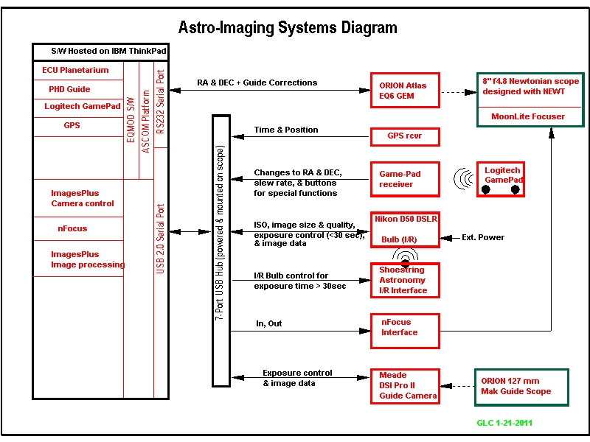

Slide 46
Examples of Advanced Imaging w/ Nikon D50 DSLR Camera
Most of the following images are the result of 20 -30, 2 or 3 minute exposures at ISO 800 for a total exposure of about 60 minutes. All frames were computer processed with dark and flat frames, aligned, stacked, combined, and then contrast stretched using digital development techniques. No special s/w filters were used in post-processing

Slide 47
M31 Andromeda Galaxy

Slide 48
Double Cluster w/Comet Hartley 2
Short exposure to avoid blurring of Hartley 2

Slide 49
Double Cluster – long exposure

Slide 50
Horsehead & Flame Nebula
No filters used

Slide 51
M13 – Globular Cluster in Hercules

Slide 52
M17 – Swan Nebula

Slide 53
M21 – Trifid Nebula

Slide 54
M27 Dumbbell Nebula

Slide 55
M11 – Wild Duck Cluster

Slide 56
M8 – Lagoon Nebula & open cluster

Slide 57
M16 – Eagle Nebula

Slide 58
M33 – Triangulum Galaxy

Slide 59
M42 & M43 in Orion

Slide 60
M51 – Whirlpool Galaxy

Slide 61
M74 - Spiral Galaxy

Slide 62
M81 & M82 Galaxies

Slide 63
M110 – companion galaxy to Andromeda

Slide 64
Moon

Slide 65
- Rosette Nebula

Slide 66
M57 – Ring Nebula

Slide 67
IC405
Note the asteroid track in the lower left-hand corner

Slide 68
Questions???
My email address:
greg_comegys@charter.net

